Slide 1


Tata Data Visualization
Empowering Business with Effective Insights virtual experience program

Slide 2
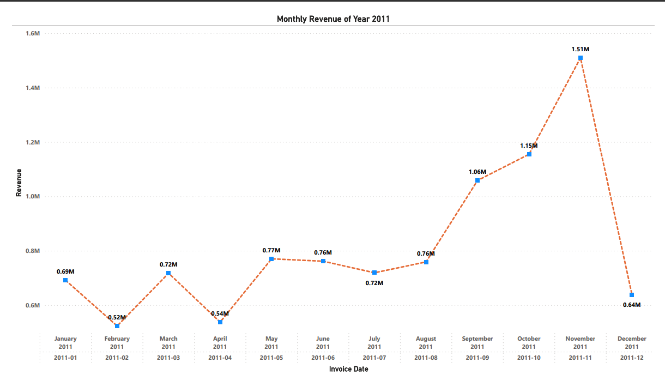
Question-1

Slide 3
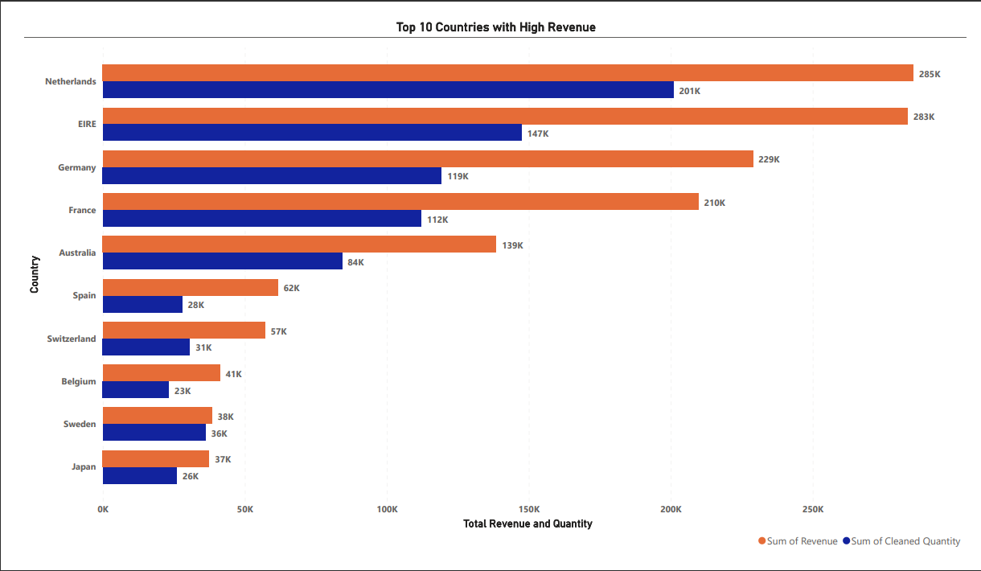
Question-2

Slide 4
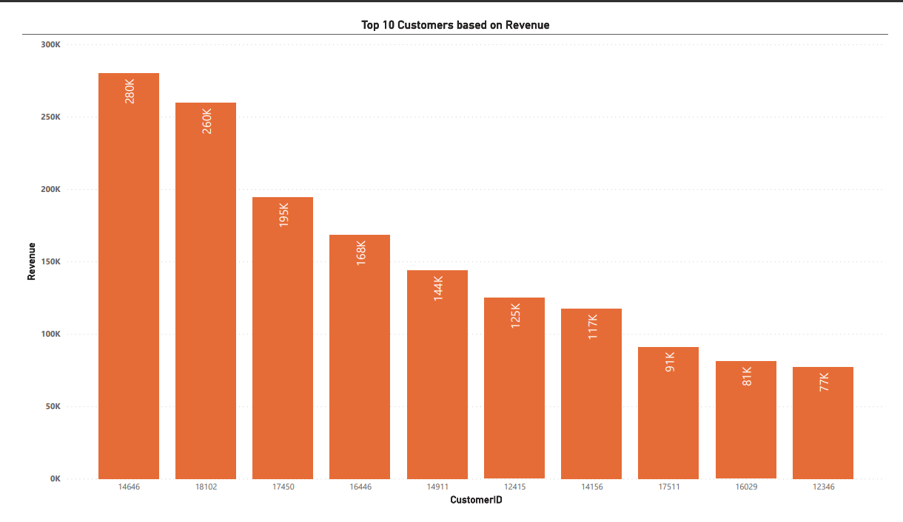
Question-3

Slide 5
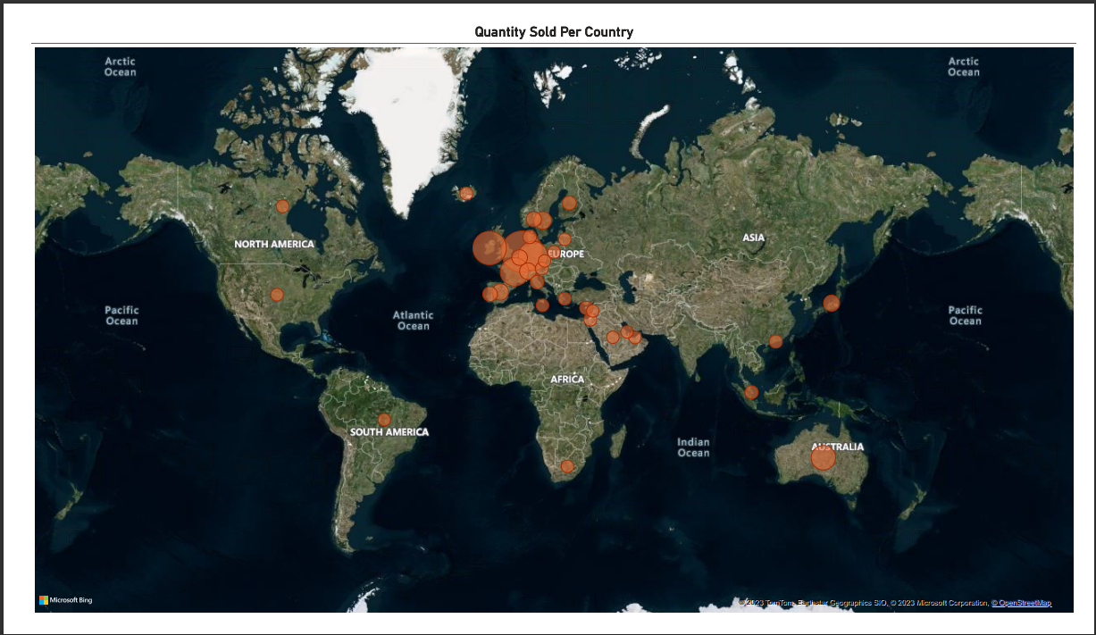
Question-4

